Slide 1
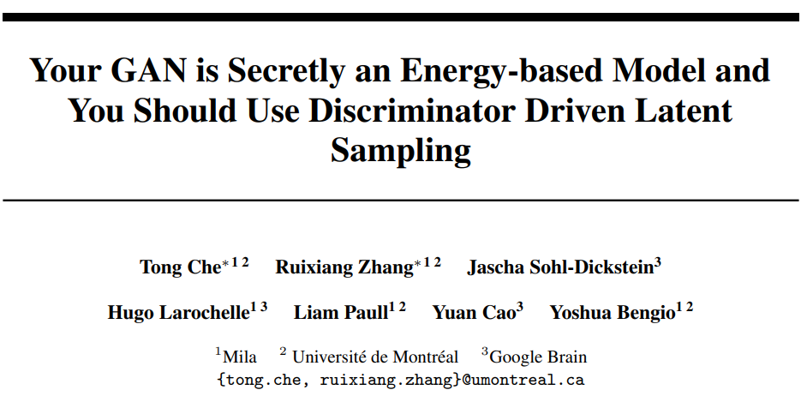
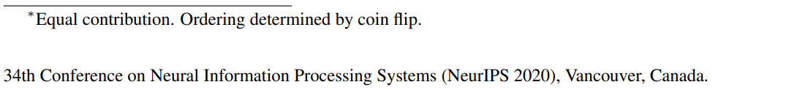
Team members: Mmesomachi Nwachukwu, Marina Morozova

Slide 2
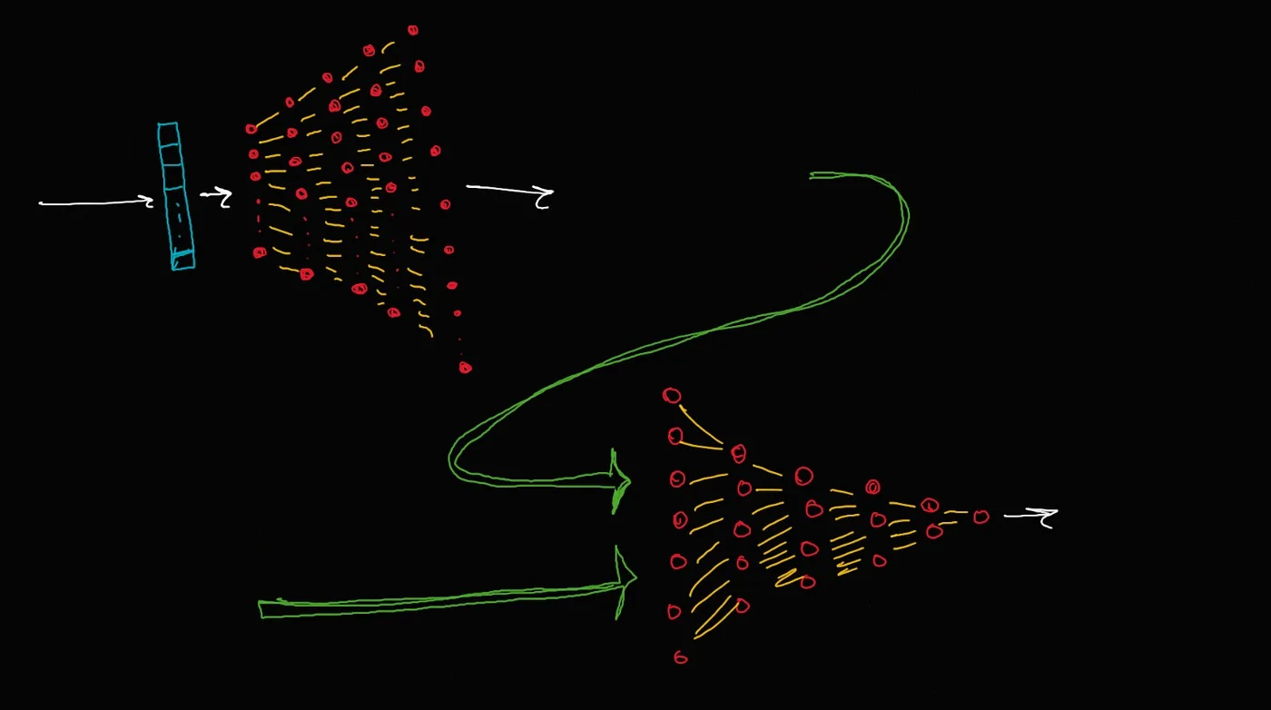
Noise vector
Z
Output of generator
(Fake data)
G(Z)
Generator
network
G
Fake or
Real?
Real samples from Training data
X
Discriminator
network (binary classifier)
D

Slide 3
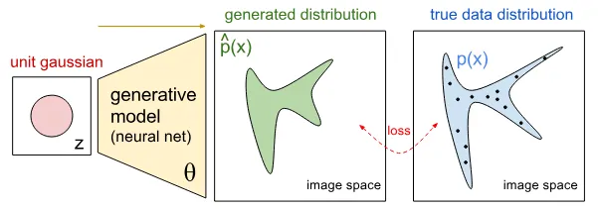
What distributions do we have here?
Distribution of noise vector Z (typically, Gaussian or Uniform)
Distribution of generated fake images P_{G(Z)} - p_{g} in the article
Distribution of training data P_{X} - p_{d} in the article

Slide 4
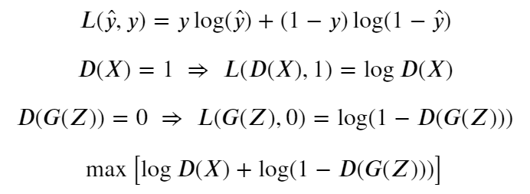
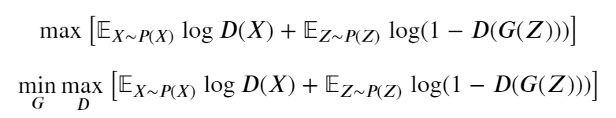
Adversarial loss function
Because Discriminator is a binary classifier we may derive its loss function from binary cross-entropy loss
The adversarial loss can be optimized by gradient descent. But while training a GAN we do not train the generator and discriminator simultaneously, while training the generator we freeze the discriminator and vice-versa!
Over batch we use Expected value
Generator minimises the same loss

Slide 5
Wasserstein GAN (WGAN)
In WGAN, there is critic instead of discriminator
Changes in the code are minor:
Use a linear activation function in the output layer of the critic model (instead of sigmoid).
Use Wasserstein loss to train the critic and generator models that promote larger difference between scores for real and generated images.
Constrain critic model weights to a limited range after each mini batch update (e.g. [-0.01,0.01]).
Update the critic model more times than the generator each iteration (e.g. 5).
Use the RMSProp version of gradient descent with small learning rate and no momentum (e.g. 0.00005).

Slide 6
GANs as an Energy-Based Model
What are Energy Based Models (EBMs)?
According to the article, these are models defined by the Boltzman distribution which varies as e^{E(x)}, where E(x) is the energy function.
The authors of article then show that, when the GAN is near optimality, the distribution of training data, p_{d} very closely varies as e^{logit(D(x))} which is the Boltzman distribution and hence, GANs can be viewed as EBMs.

Slide 7
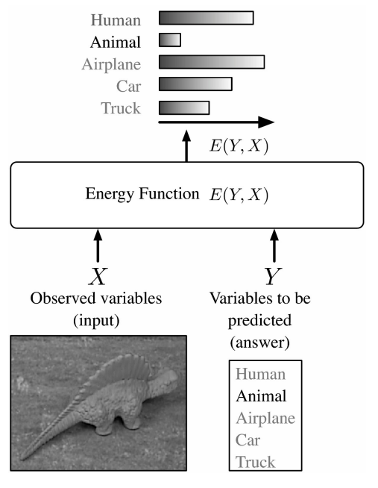
GANs as an Energy- Based Model
Energy-based models (EBMs) assign an unnormalized log probability to data samples
Energy models have been a popular tool before the huge deep learning hype around 2012 hit
In recent years, energy-based models have gained increasing attention because of improved training methods and tricks being proposed
In authors formulation, GAN generators and discriminators collaboratively learn an “implicit” energy-based model

Slide 8
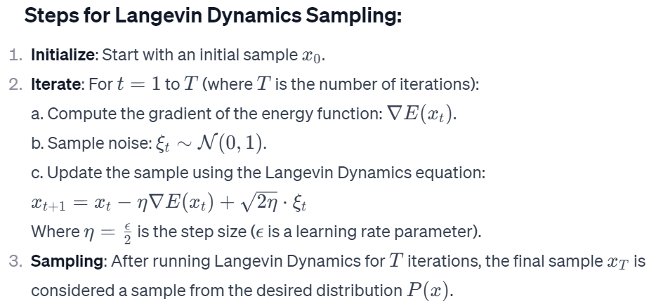
Sampling from Energy-Based Models
Sampling from Energy-Based Models (EBMs) refers to the process of generating new data points from a probabilistic model defined by an energy function
For sampling from an energy-based model, we can apply a Markov Chain Monte Carlo (MCMC) using Langevin Dynamics, but:
Doing MCMC in pixel space to sample from the model is impractical due to the high dimensionality and long mixing time.
Distribution of P_{G(Z)} is implicitly defined and its density cannot be computed directly

Slide 9
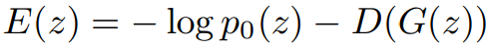
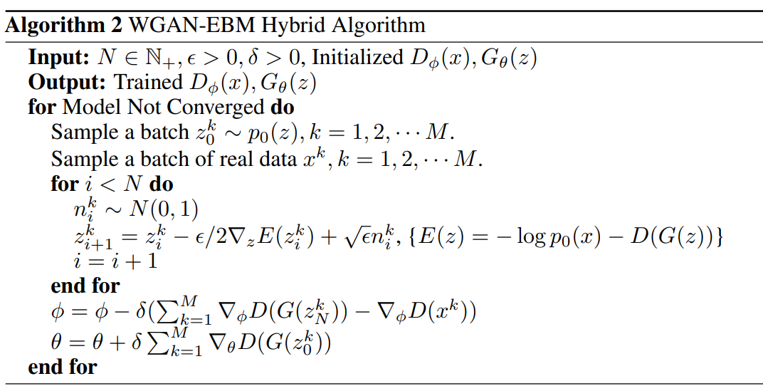
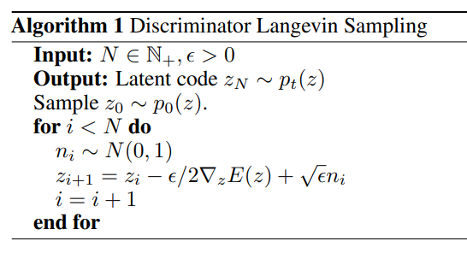
Energy-based model in the latent space
Rejection Sampling and MCMC in Latent Space
Discriminator Driven Latent Sampling on the WGAN latent space to generate improved samples with the energy function, where p₀ is prior proposal distribution

Slide 10
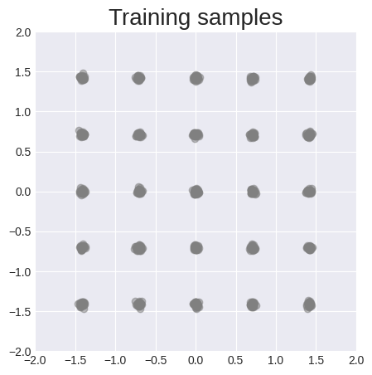
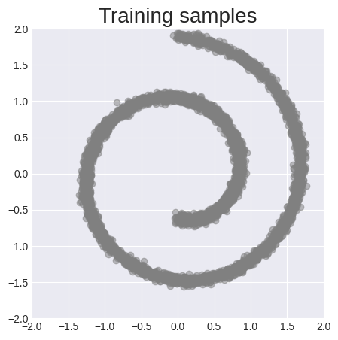
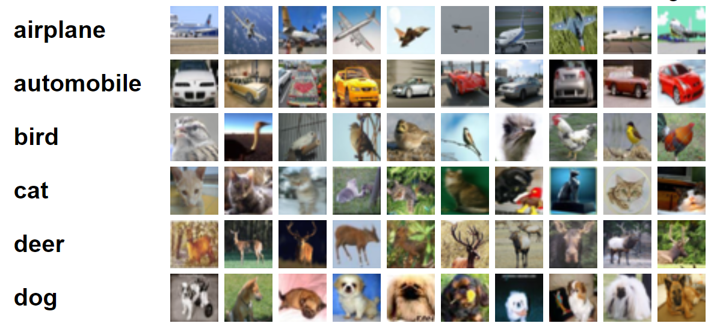
Experiments
Synthetic dataset
CIFAR-10 dataset

Slide 11
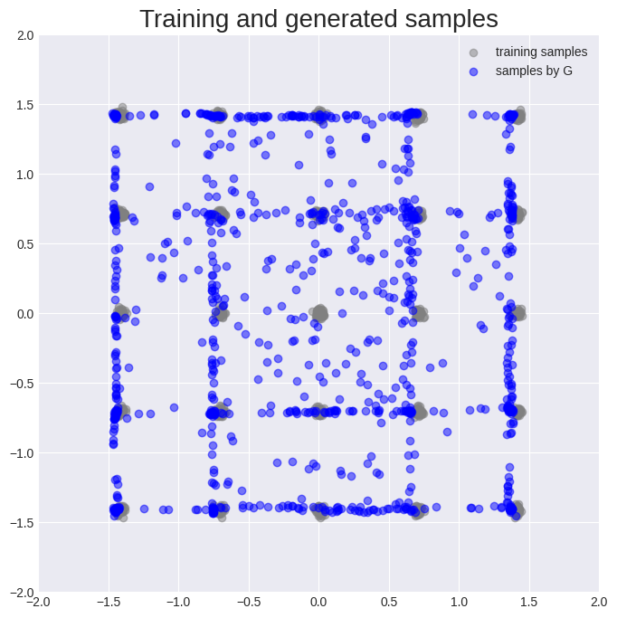
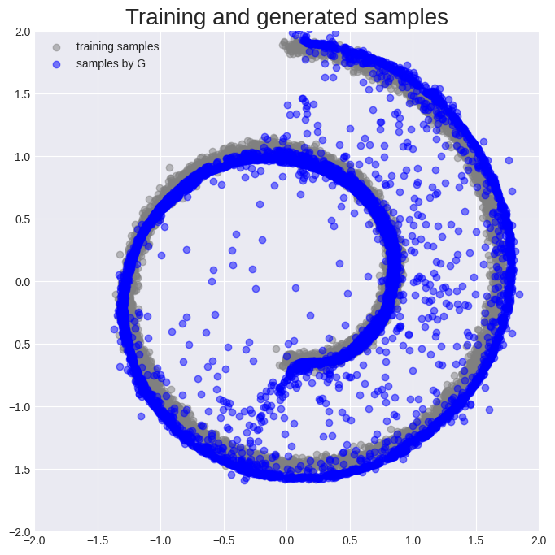
WGAN-GP training

Slide 12
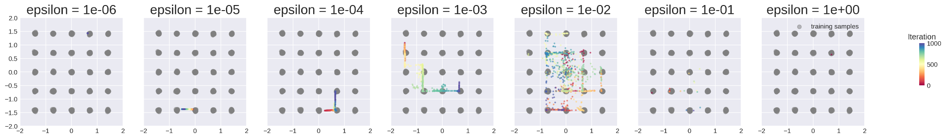
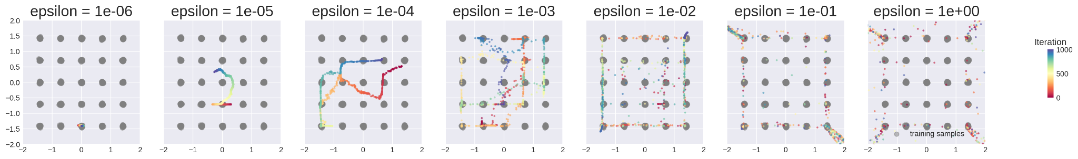
Timelapse
“Rainbow” is timelapse of how generated values are changing when latent space is changed
With an additional layer of M-H sampling (MALA algorithm)
Without MALA algorithm

Slide 13
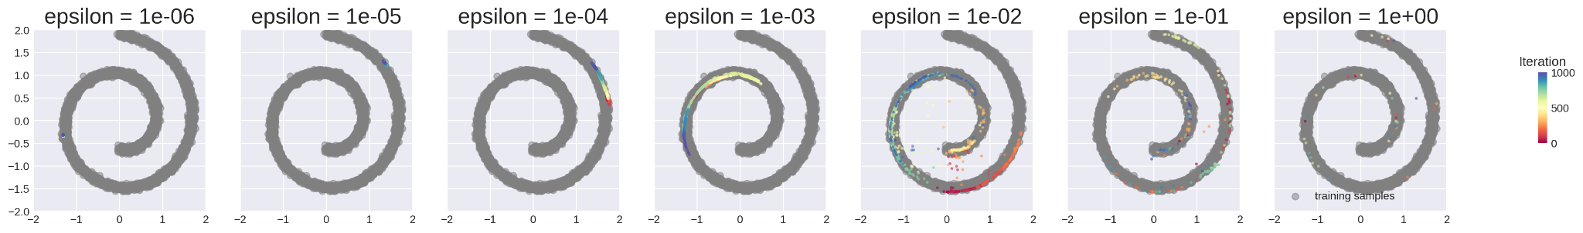
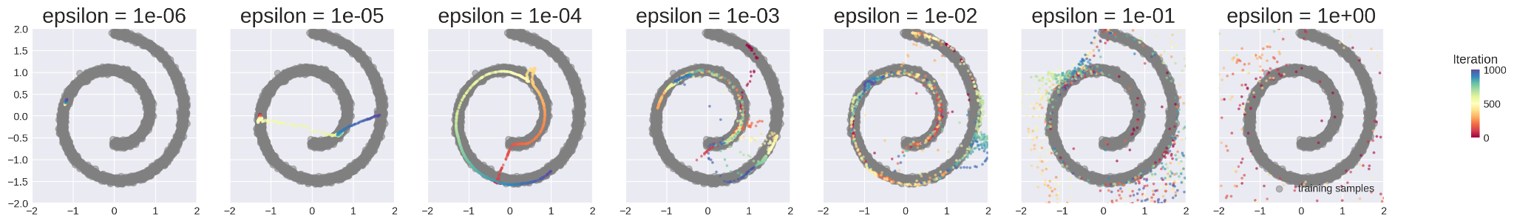
Timelapse
“Rainbow” is timelapse of how generated values are changing when latent space is changed
With an additional layer of M-H sampling (MALA algorithm)
Without MALA algorithm

Slide 14
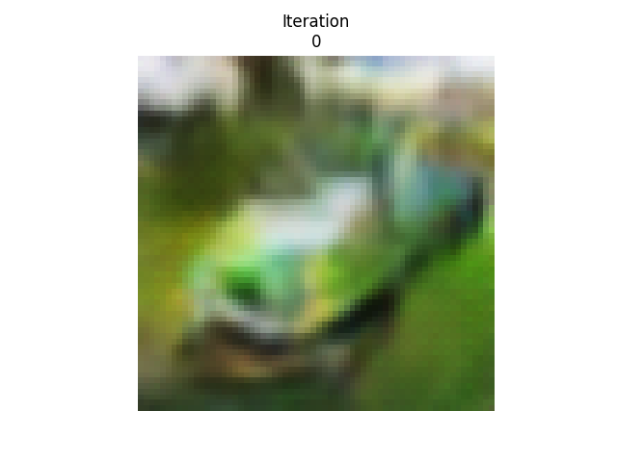
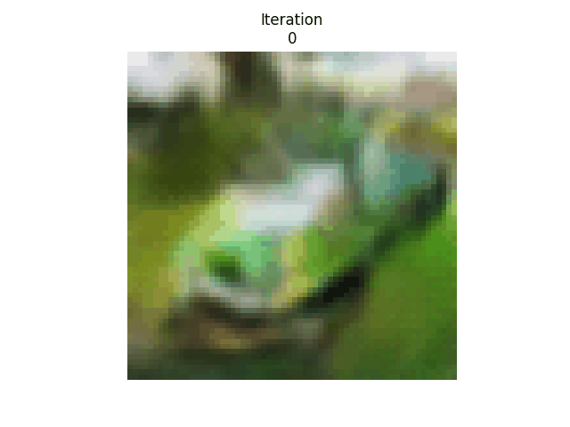
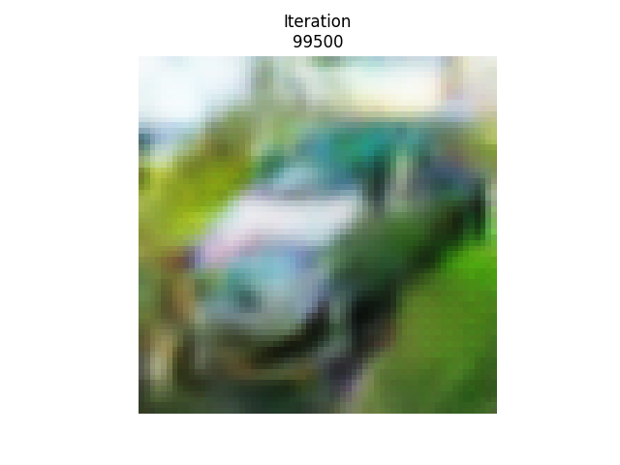
CIFAR-10 dataset
We trained small Resnet-like WGAN
An example of further refinement of noise vector to generate more clear picture of car

Slide 15

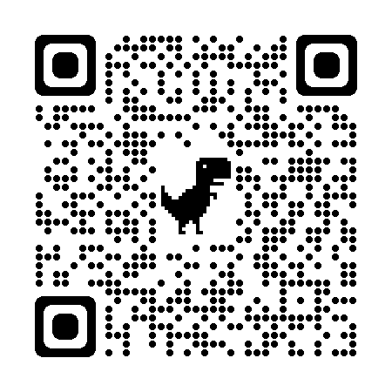
Conclusions
There other methods for manipulations with Latent Space of GANs (for example, Discriminator optimal transport (DOT))
Discriminator Driven Latent Sampling (DDLS) is implemented in several libraries and repositories (big credits to Daniil Selikhanovych)
The paper is reproducible but the are no open code and most derivations are difficult to follow through
GitHub: MarkaMorozova/ Discriminator-Driven-Latent-Sampling

Slide 16
Thank you for your attention

Slide 17
